Slide 1

Classification Project
Loans Eligibility Prediction
Evgenia Samsonov and Idan Leibovitch

Slide 2

Mission statement
Dream Housing Finance company deals in all home loans. They have a presence across all urban, semi-urban, and rural areas. Customer-first applies for a home loan and then the company validates the customer eligibility for a loan.
Goal :
Create automated tool for loans qualification process by the given data.

Slide 3

Overview
EDA with Pandas and Seaborn
Preprocessing the data, convert categorical to numerical, handling missing values
Prepare for models (fit models, normalize, oversampling)
Apply classifications models for comparing results of scores
Model Comparison and choosing best one of scores for business inquiries
Conclusions and insights

Slide 4

EDA and Preprocessing the data
Loan_ID--------------> Unique Loan ID
Gender --------------> Male/ Female
Married --------------> Applicant married (Y/N)
Dependents ------------> Number of dependents
Education -------------> Applicant Education (Graduate/ Under Graduate)
Self_Employed ---------> Self-employed (Y/N)
ApplicantIncome -------> Applicant income
CoapplicantIncome -----> Coapplicant income
LoanAmount -----------> Loan amount in thousands
Loan_Amount_Term ------> Term of a loan in months
Credit_History --------> Credit history meets guidelines
Property_Area ---------> Urban/ Semi-Urban/ Rural
Loan_Status -----------> Loan approved (Y/N)
There are 614 entries
There are total 13 features
There are three types of datatype : float64(4), int64(1), object(8)
There are three many missing values (146 NaN).
Loan_Status feature Boolean values, So we replace Y values with 1 and N values with 0 and same for other Boolean types of columns, "Male": 1, "Female" : 0 After replacing we will use median, mean and mode with NaN values.

Slide 5
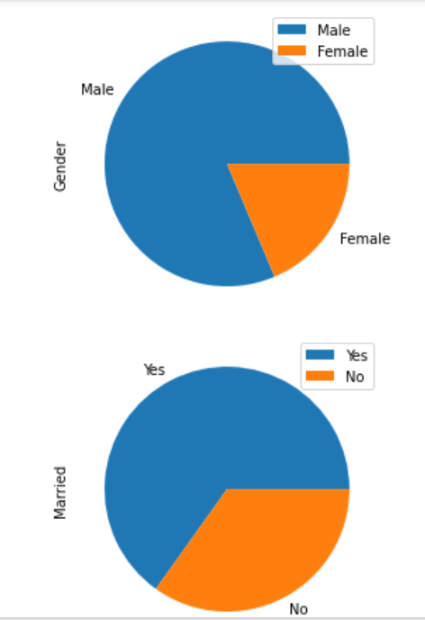
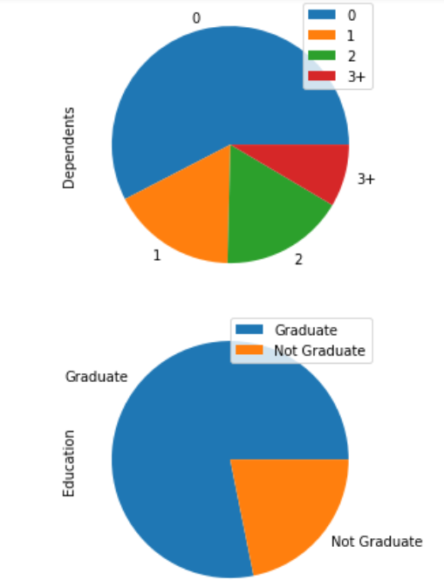
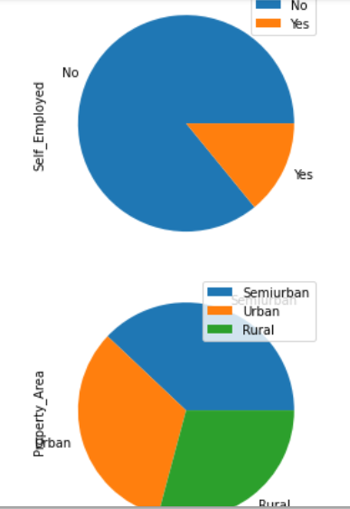
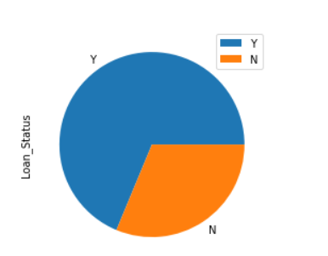
EDA
Explore object type with value_counts

Slide 6
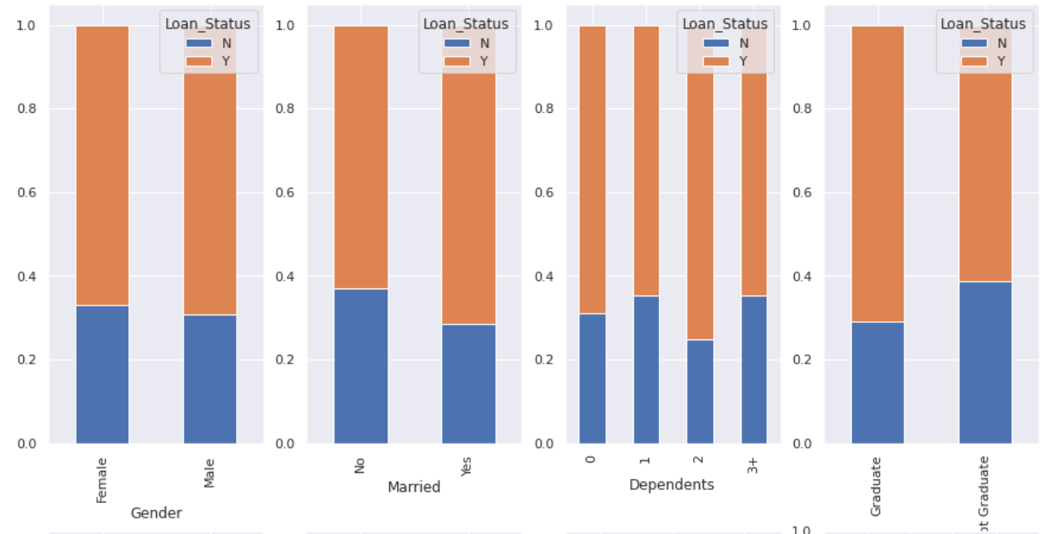
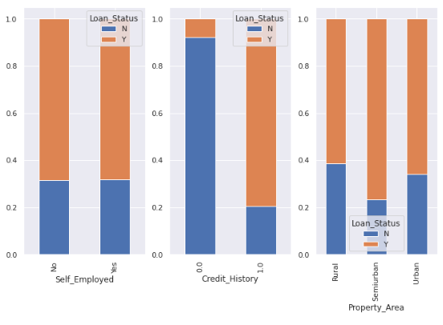
EDA
Explore Loan_Status by each feature

Slide 7
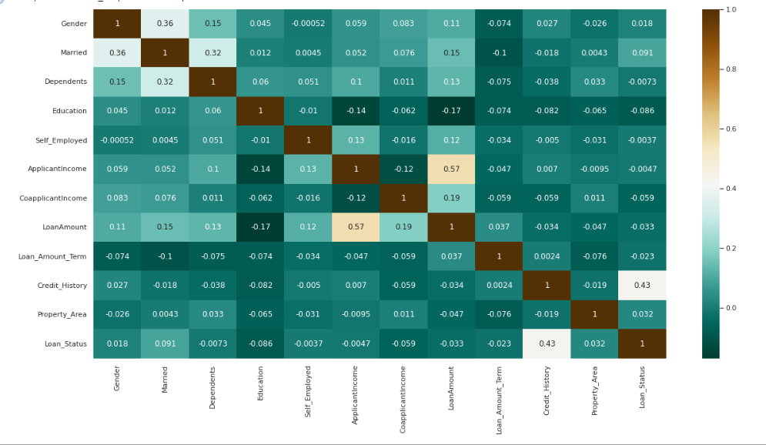
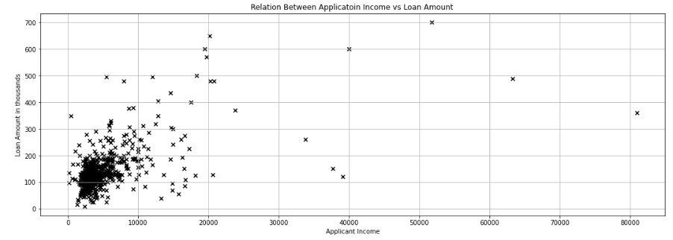
EDA
Heatmap reflects the strong relations between loan_status and credit_history, as well for Application_income and loan_amount
Plot shows relation between Applicant Income vs requested Loan Amount.

Slide 8
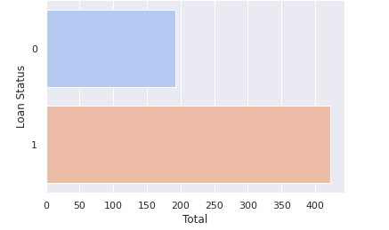
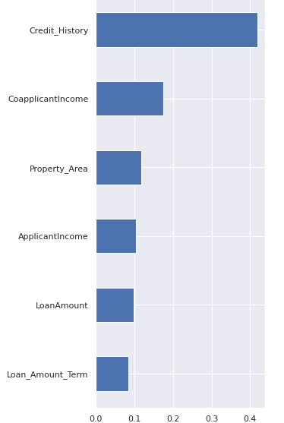
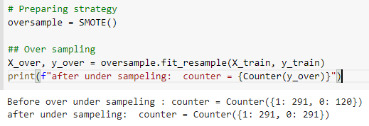
Preparing for models
3. Feature importance: Credit_History, CoapplicantIncome, Property_Area, ApplicantIncome, LoanAmount, Loan_Amount_Term
1.Target variable-Loan_Status
2. Over sampling by SMOTE (Imbalanced data)

Slide 9
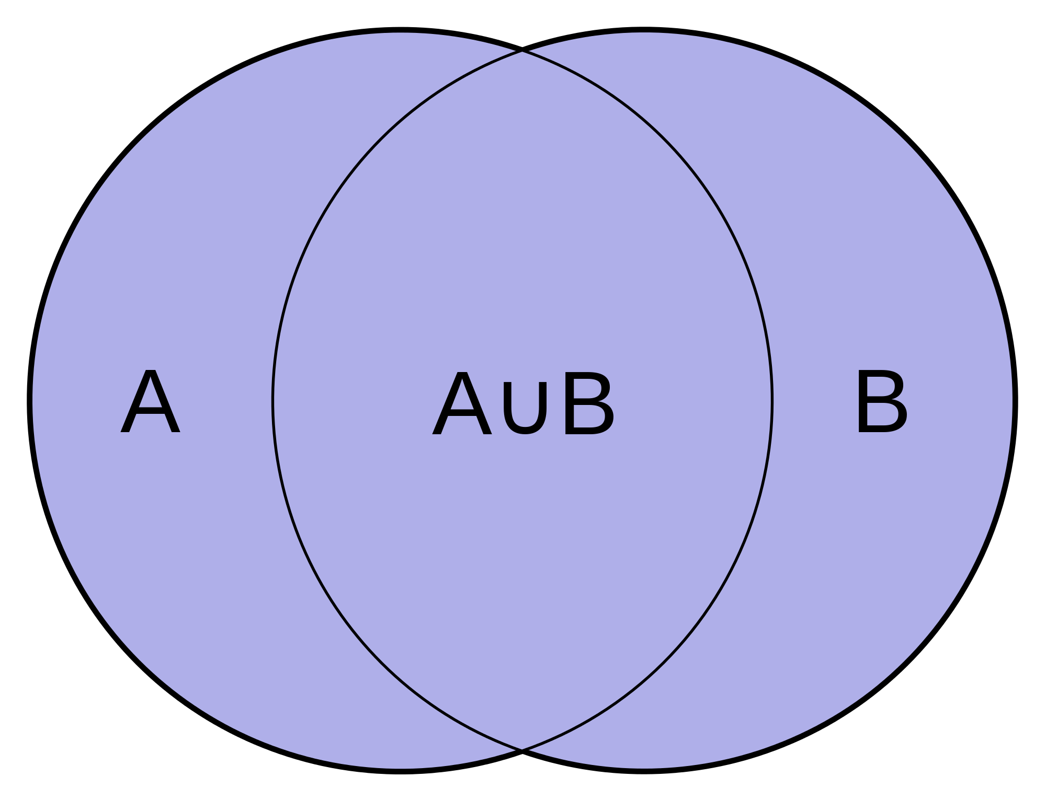
Classification models
Gradient Boosting
Ada boosting on Logistic Regression and Decision Tree
Logistic Regression
KNN
Decision Tree
Random Forest
Running the models with:
1.Clean (regular) data
2.Normalized data
3.Balanced target
4.Features important

Slide 10
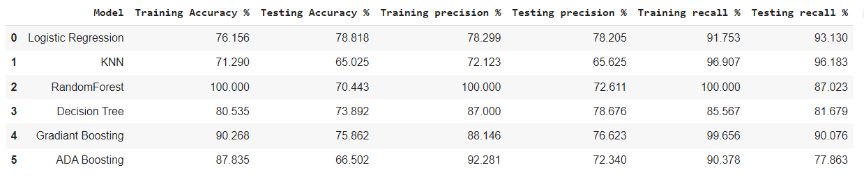
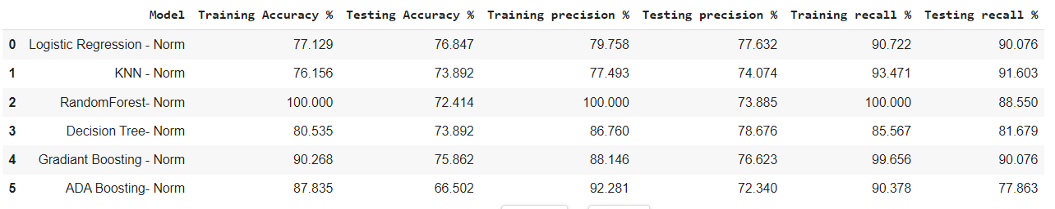
Models with clean (regular) data
Models with normalized data

Slide 11
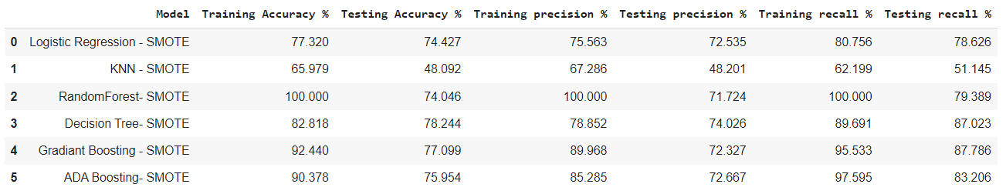

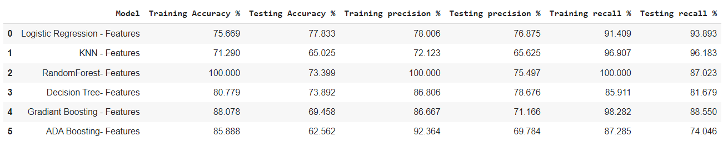
Models with balanced target
Models with features important

Slide 12

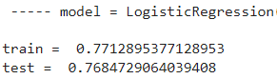
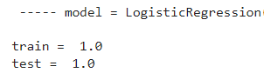
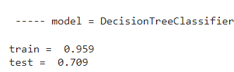
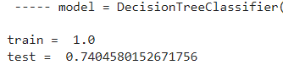
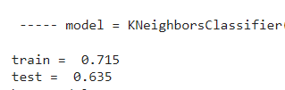
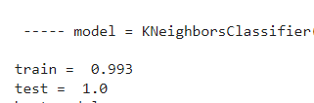
Grid search
scoring=’accuracy’
scoring=’recall’

Slide 13
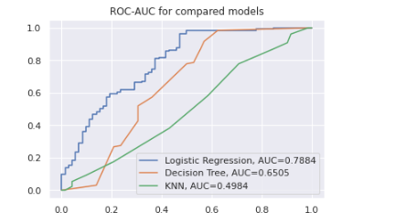
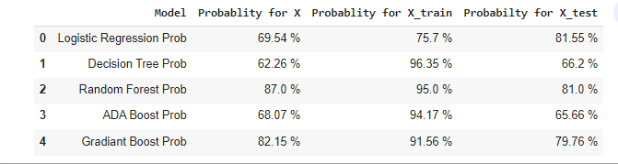
ROC-AUC
Probability by specific data line

Slide 14
Insights and Conclusions
Business’ problem/question is affecting on the model and metric need to be chosen:
For general accuracy if to approve/disapprove the loan we will use the ‘accuracy’ metric and the score is 77%.
For only approved loans with low risk -we’ll use the recall metric which has high score of 100% actual loans approved from the predicted .
For recall and precision metrics our score for “0” (unapproved loans) is very low. This must been taken in consideration if proceeding with those metrics.
Future plans :
Find the best models for unapproved loans, getting the complete business solution.
Testing more models for getting higher accuracy score and AUC closer to 1.
Examining the threshold for each model

Slide 15

Thank You for your time

